Slide 2
Love is the Litmus Test 1 John 3:11-24

Slide 5
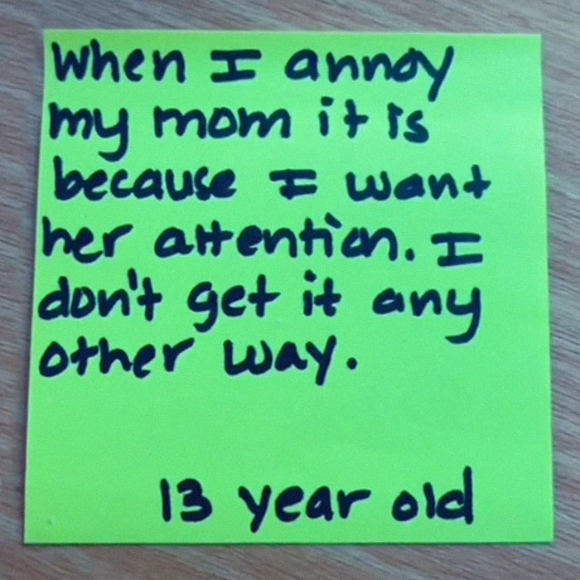
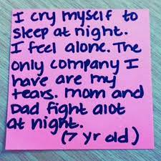

Slide 6
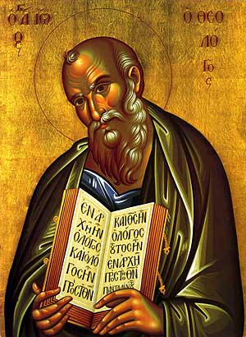
"We know love by this," he says to his brothers and sisters in Christ, "that he laid down his life for us."
(1 John 3:16)

Slide 7
“John asks his followers, "How does God's love abide in anyone who has the world's goods and sees a brother or sister in need and yet refuses to help?" (v. 17).

Slide 8
John says that we'll know that God lives in us "by the Spirit that he has given us" (v. 24).
This new link between belief and love creates a new kind of life for us.
A life that is fixed on Jesus Christ.

Slide 9
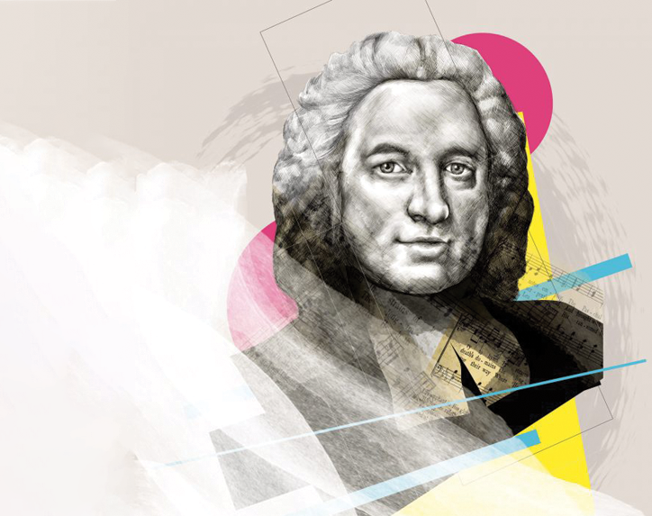
To love God and love One Another was all one piece for John Wesley.
Piety
what we do to stay in love with God.
Justice Ministry
what we do to stay in a healthy relationship with our neighbor.

Slide 12
Love is the Litmus Test 1 John 3:11-24

